Slide 1
Google Web Tool Kit (aka GWT) The Fundamentals
12/16/2014

Slide 2
GWT Overview
Development toolkit, not a framework
For Building interactive web sites
Code in Java, run as JavaScript so, basically you can write your front end code in Java (and HTML)
Make AJAX Web simpler and easier
One codebase, any browser
Browser independent
Browser support: FF, IE, Chrome, Safari, Opera

Slide 3
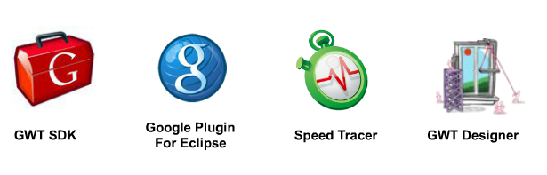
GWT Family

Slide 4
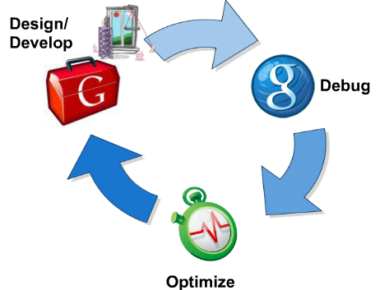
Basic flow of development
Generate a GWT-Project
Write Java Code
Run GWT Compiler
Deploy and View results

Slide 5
Benefits - Developers
Leverage existing IDEs and Tools
Minimize refresh time between codes changes
Use Java language for develop web UI (like the Java Swing)
Easy to control the project structure as Java project
Reduce coding typo mistake… (since you’re not deal with JavaScript code)
Reduce compatible browser bug fixing effort => increase productivity

Slide 6
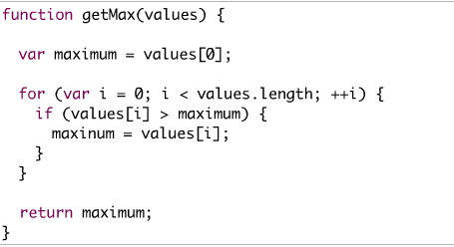
JS Code: Can you find the typo bug

Slide 7
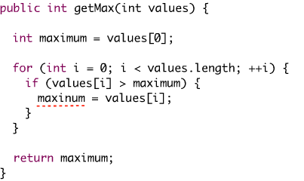
Code in Java Code: Easy to find

Slide 8
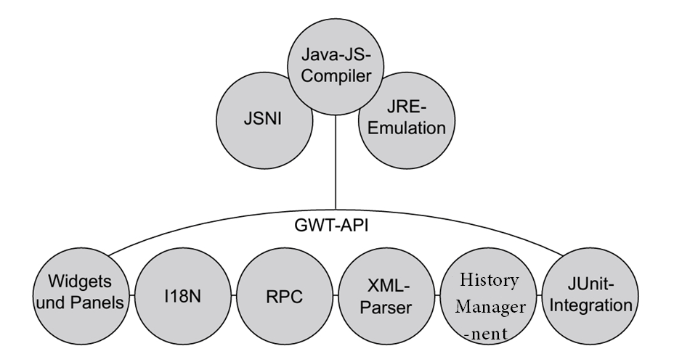
GWT Components and APIs

Slide 9
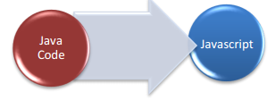
Components - JavaScript Compilers
GWT Compiler converts Java code into JavaScript code
Bytecode won‘t work! (.java classes sourcecode only)
Javascript generated was optimized
Dead code removal, Type tighten, inlining, aggressive obfuscation, etc…
Java codes which are suppose to be compiled in to JavaScript needed to be JDK (Java Development Kit) 1.5 compliant
Generate Bootstrap- script (*.nocache.js)
Three style modes for compile:
Obfuscate (compact) everything is compressed
Pretty (methods)
Detailed (meth. & qualified class name) e.g. function java_lang_Object_toString__(){…

Slide 10
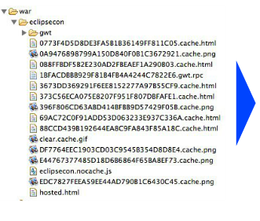
Components - JavaScript Compilers cont
Compiler generates output files for every permutation:
Browser types x Locale
=> separate outputs.
Each *.cache.html is a browser and language specific version of the app

Slide 11

Components - JSNI (JavaScript Native Interface)
The JavaScript Native Interface, or JSNI for short
Idea:
Write Java methods that call JavaScript
Write Native JavaScript code that can call Java
Allows us to execute JavaScript from Java, as well as execute Java from JavaScript

Slide 12
Components - JSNI (JavaScript Native Interface) cont
This is made possible by the GWT compiler that can merge native JavaScript code with the JavaScript code that is generated from Java
Direct JQuery calls (GQuery)
DOM programming through Java Overlay types
Binding of a Java object to a Javascript object
IDE advantages
Use JSON objects as Java objects
Friendly usage of Javascript lib’s

Slide 13
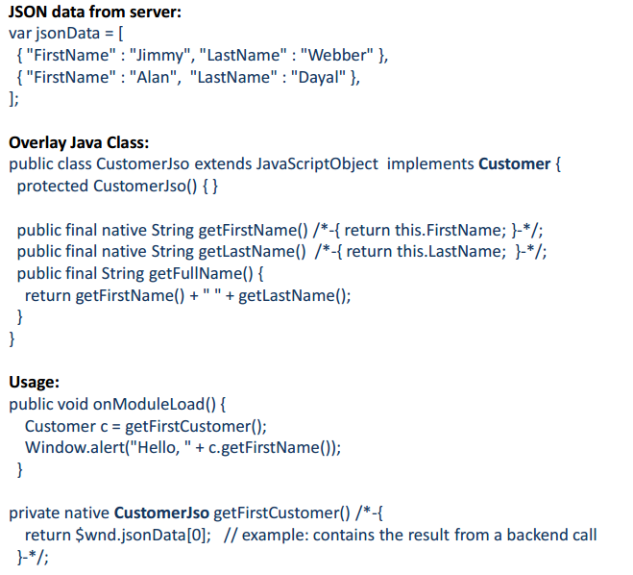
DOM programming through Java Overlay types Example
More info: https://developers.google.com/eclipse/docs/gwt_jsni

Slide 14
Components – JRE Emulation Library
JRE Emulation Library
this library contains the most commonly used parts of the full JRE, which may be used in your projects and can be compiled to JavaScript
Emulator differs slightly from Java Implement
Java.lang.*
Java.util.*
(basically: Datatypes, Exceptions, Collections supported)
Eg: Finalization: JavaScript does not support object finalization during garbage collection, so GWT is not able to be honor Java finalizers in production mode.
Differs can be referenced through this link: http://www.gwtproject.org/doc/latest/DevGuideCodingBasicsCompatibility.html

Slide 15
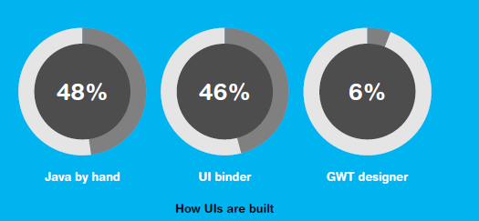
Components - Widgets and Panels
GWT ships with a large set of widgets and panels available for use
Instead of layout managers GWT provides a set of panels that display their children in a specific manner
Ways of use:
JAVA :Generate UI Widgets from JAVA code (Similar to programming SWING)
UI Binder: based on XML files to design structure of the view
GWT Designer: drag and drop, JAVA code automatically generate

Slide 16
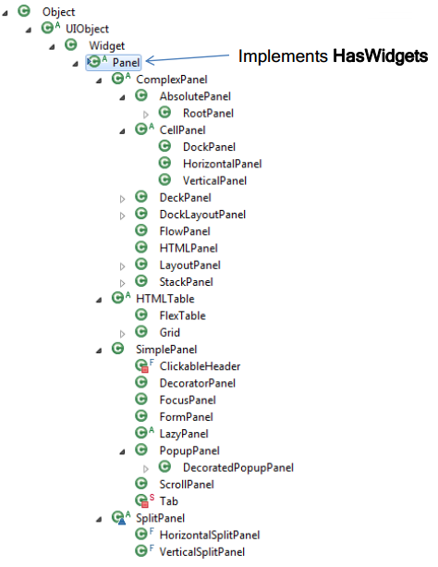
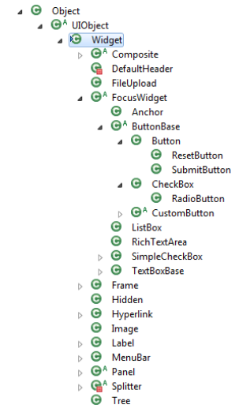
Widget and Panel Java Hierarchy

Slide 17
Components – I18N (Internalization)
Idea:
Support multiple languages
GWT includes a flexible set of tools to help you internationalize your applications and libraries.
Two mechanisms :
More Details: http://www.gwtproject.org/doc/latest/tutorial/i18n.html
Static (compiled)
Messages
Constants
Dynamic (runtime)
Dictionary

Slide 18
Components – AJAX Communication
2 common ways
Base on XMLHttpRequest
GWT RequestBuilder (Wrapper)
GWT-RPC
Strings/ Xml
Method invoke

Slide 19
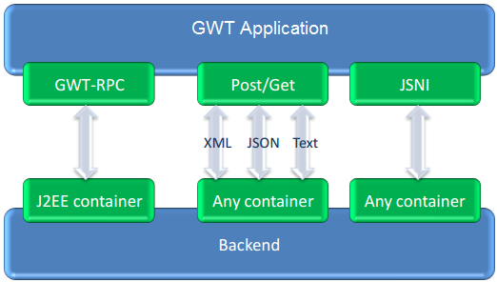
Components – AJAX Communication cont
Communication basics:
• GWT-RPC (java backend)
• Post/Get (any backend) use HTTP types
• JSNI the traditional way (not recommend)

Slide 20
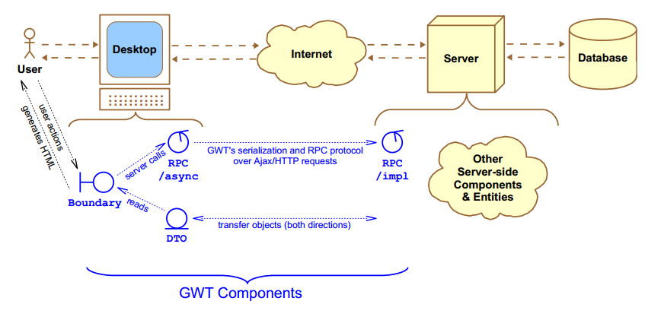
Components – AJAX Communication - RPC
Goals:
Transparent backend connection
Java Object sharing
Lightweight mechanism

Slide 21
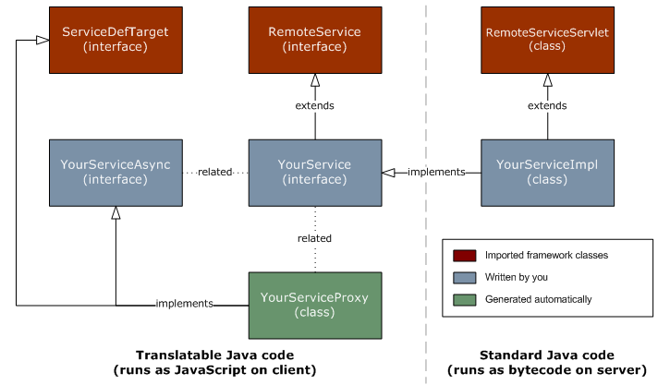
Components – AJAX Communication – RPC cont
More details: http://www.gwtproject.org/doc/latest/DevGuideServerCommunication.html

Slide 22
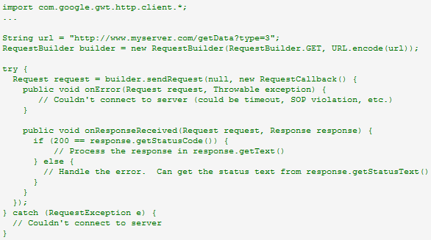
Components – AJAX Communication – HTTP Types
<inherits name="com.google.gwt.http.HTTP" /> in module xml file
Use RequestBuilder as maker for request
Eg:

Slide 23
Components – XML Parser
The GWT class library contains a set of types designed for processing XML data
Add <inherits name="com.google.gwt.xml.XML" /> in module xml file for use.
Work with Document, Node, Element object after parsing to extract data.
More details: http://www.gwtproject.org/doc/latest/DevGuideCodingBasicsXML.html

Slide 24
Components - History Management
Why:
GWT applications are normally single page application running JavaScripts
Back button: do you want browser’s “back” and “forward” buttons to have any meaning?
Bookmarking: Do you want to enable user to bookmark a screen and navigate to there later.
To use browser's history functionality, application should generate a unique URL fragment for each navigable page
GWT provides History Mechanism to handle this situation.

Slide 25
Components - History Management cont
Token:
Simply a string that the application can parse to return to a particular state.
Application will save this token in browser's history as URL fragment.
Begin after hashTag “#”
Eg: http://www.gwt.com/abc.html#pageNumberOne has token = ‘pageNumberOne’
More info: http://www.gwtproject.org/doc/latest/DevGuideCodingBasicsHistory.html

Slide 26
Components - History Management cont
newItem(token:String) => trigger application to move to another token
History
onHistoryChanged(token:String)
HistoryListener
addHistoryListener *
implements
onHistoryChanged(token:String) => code execute when history change
HistoryListenerImpl

Slide 27
Component – Junit Integration
Unit test class musts extends GWTTestCase class.
You can create additional test cases by extending this class.
Acts as a bridge between the JUnit environment and the GWT environment.
getModuleName method in Test class must return exact the name of the GWT module going to be tested.
More details: http://www.gwtproject.org/doc/latest/tutorial/JUnit.html

Slide 28
Widget Event Handling
The same approach as with Swing, AWT, SWT, Android
=> Handler will be attached to Widget, Event triggered and being captured by Handler. Handler will handle that event for specific manner.
Write event handlers using the same way as desktop java GUI programming
The code will get compile to JavaScript at the end.

Slide 29
Widget Event Handling – General Approach
Make a control:
TextBox textField = new TextBox();
Attach Event handler to it (3 alternative ways)
Using separate class or named inner class that implement KeyUpHandler
Eg: textField.addKeyUpHandler(new MyKeyUpHandler());
Current container class hold textField and implement KeyUpHandler
Eg: textField.addKeyUpHandler(this);
Using anonymous inner class during attachment
Eg: textField.addKeyUpHandler(new KeyUpHandler() {…..});

Slide 30

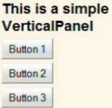

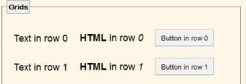
Laying out Windows with Panels – Simple Panel
Basic Panel types:
VerticalPanel (to put widget side by side)
HorizontalPanel (to put wiget on top of each other)
FlowPanel (layout widgets as natural HTML div flow)
Grid (put widgets in tabular with fixed cell size)
FlexTable (same with Grid + dynamic resize when
add row or column on the fly + support multiple
column and row span)

Slide 31
Laying out Windows with Panels – Layout Strategies
HTML-Based Layout
Write HTML by hand, designate places for individual controls
HTML body contains a lot of content
Best when GWT used for
A traditional web app with some pieces of Ajax-enabled content for GWT
Complex page where HTML layout does not change
You need the HTML content indexed by a search engine

Slide 32
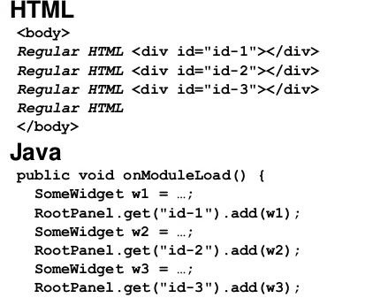
HTML-Based Layout Example

Slide 33
Laying out Windows with Panels – Layout Strategies cont
Java-Based Layout
Attach main layout panel to HTML <body> element
Java uses Panels to build up overall layout
Attach widgets into panels to form the view
Best when GWT used for
Control the code based like Java Desktop Application
Create an application where HTML change on-fly
OOP the layout

Slide 34
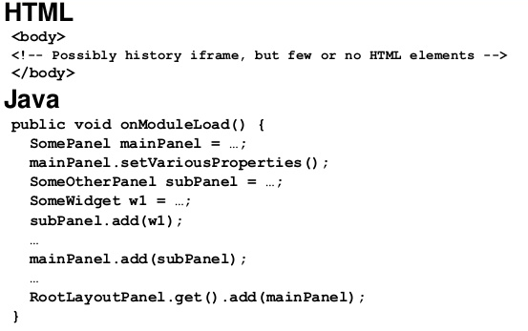
Java-Based Layout Example

Slide 35
Laying out Windows with Panels – Layout Strategies cont
Declarative layout - UiBinder
Use XML file to layout content
Can represent HTML or a Widget
Make Java class that represent of that content
Use that Java class in GWT application
Benefits:
Can make complex layout using HTML
Graphic Web designers can be involved in from design to maintenance
Separate of concerns, UI layout and UI functionality no longer mashed together.
Big Disadvantage: there are at least two files for every component
More Details: http://www.gwtproject.org/doc/latest/DevGuideUiBinder.html

Slide 36
Method supported by Most Panels
add(Widget w)
Adds a widget to panel. Where it get inserted depends on the Panel type.
Most Panels supports “insert” to put Widget in specific place
All Panels support “remove” (one widget) or “clear” (all)
The widget that you add can itself be a Panel
Many Panels have specialized versions of add method with extra args
setSize, setWidth, setHeight(String value): take CSS-style size descriptors as parameter (String based)
addStyleName: for css styling, this will set class name for apply css on the panel
getChildren, getWidget, getWidgetCount: look up information about the widgets already inside the Panel.

Slide 37
Questions

Slide 38
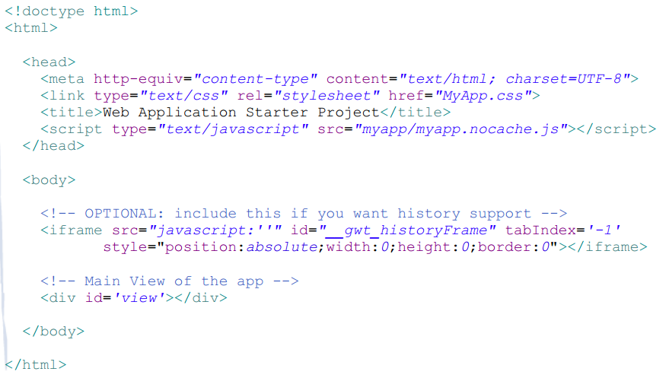
Example: GWT Root Page

